Slide 1




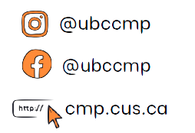

COMMERCE MENTORSHIP PROGRAM
MIDTERM REVIEW SESSION
COMM 393
Prepared by: Molan Liu and Tommy Zhang
Instructed by: Molan Liu and Tommy Zhang
Emails: tommyzhang0000@gmail.com
liumolan@hotmail.com

Slide 2
Advice
Identify the correct legal situation. Not identifying the correct legal situation will get you 0 on the question because you’re applying the wrong laws. Tommy: I used Charter for a question instead of using Ultra Vires. I almost got 0 but my prof gave me half marks. You might not be so lucky….
Certain elements of the question might push you to a bunch of different solutions because a single question stem may incorporate elements of e.g. minors (Infants Act), courts (court system), and contracts (offers, acceptance etc.)... The important thing is not to be tripped up and to make sure you identify and apply the correct law.

Slide 3
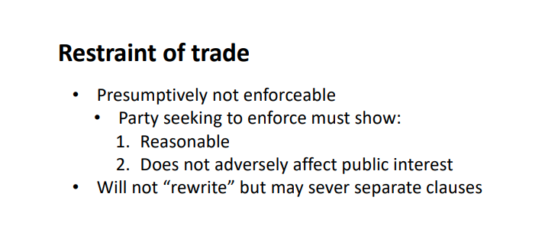
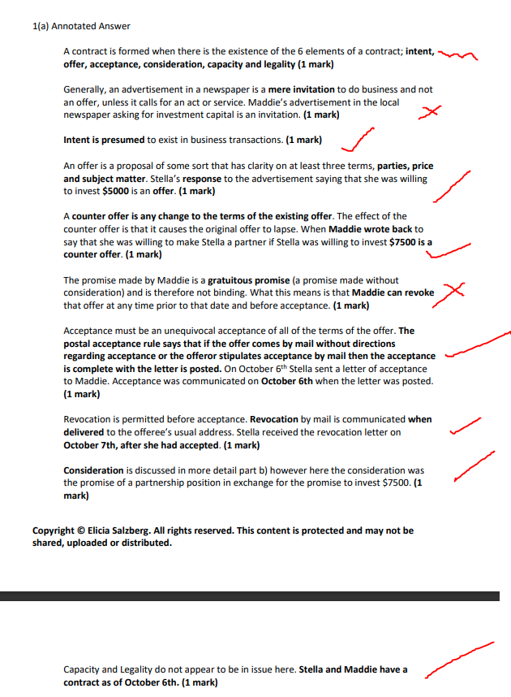
3. Understand how to apply the law.
The slides can be quite vague at times.
Like what does “Reasonable” here mean??
4. “Miscellaneous marks”
The first time I did this question, my notes were insufficient so I was not able get all the marks. The X represents “miscellaneous marks” that may not be clearly in slides.
Tip: run as many practice exams as possible and every time you see a “miscellaneous mark” that you weren’t able to get, add it to your notes.
5. MAKE GOOD NOTES
6. Stick to Time Limits
7. Law, Application, Conclusion *We recommend one line law, one line application format to not get lost
8. Answer the question asked
9. Cite where the law came from - if relevant

Slide 4
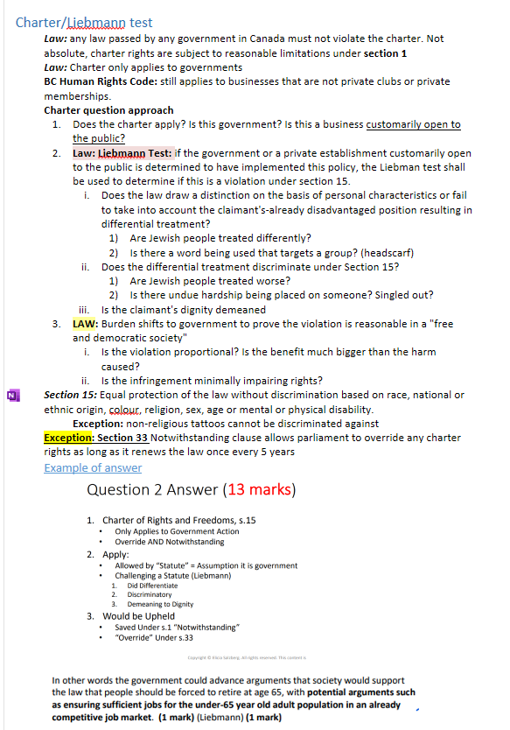
Example of my notes:

Slide 5
List of topics
Charter/Liebmann
Federalism/ultra vires
Interpretation
Restraint of Trade
Contracts
Promissory Estoppel
Minors
Forum Selection
Court systems of Canada
Undue Influence, Duress and Unconscionability

Slide 6
Question 1: Charter of Rights (2 minutes)
M&M, the owner of the Shady Cinema in Vancouver, has recently decided that he does not wish to be associated with Black employees who are residents of A street, a neighbourhood historically known for its poverty, drug abuse, and gang violence. In M’s opinion, accepting these customers will tarnish his business’ reputation as a family-friendly establishment. To do so, M instructed his bouncers to inquire whether or not cinema-goers of his enterprise were residents of A street; those who were residents of A street would be turned away. One of his loyal customers, Dre, has recently been denied access to Shady Cinema. As a result, Dre has decided to file a lawsuit against Shady Cinemas, bringing his claim under the Charter of Rights and Freedoms. He has hired you as his lawyer; what will you say to Dre regarding his chances of succeeding in court? /8 marks

Slide 7
Answers to Question 1
Related Cases: Liebmann v. Canada
ISSUE:
Can Dre challenge the policy under the Charter of Rights and Freedoms?
Is this a public/governmental issue?
*Note: You would not need to write down the issues on the exam, they are just here for reference in case you forgot what these topics entail. Related Cases are superlatives but it would be best for you to include them in your answers for extra marks.

Slide 8
Charter Laws
The Charter of Rights and Freedoms applies only to government (public) action or decision-making. After determining if the Charter applies, discrimination must be present.
Does the law distinguish based on personal characteristics or fail to consider the claimant’s already disadvantaged position resulting in differential treatment?
Does the differential treatment discriminate under Section 15? (Section 15 covers race, religion, national/ethnic origin, colour, sex, age, physical/mental disability etc…)
Is the claimant’s dignity demeaned? (Very subjective, as you may remember from the Liebmann case, Liebmann saying he was upset and depressed is enough for this part of the law to be fulfilled)
If all those above are proven, the burden shifts to the government to show valid according to Section 1, “subject to such reasonable limits as can be demonstrably justified in a free and democratic society.” [(Liebmann) This means that the government, while it may or may not have engaged in discriminatory practices, is allowed to do so as its actions are for the greater good of society.]
[ES Comment: What about s.33 override?]
section 2, section 7-10 (do not need to memorize)

Slide 9
Application & Conclusion
The Charter would apply; although this may seem like a non-governmental issue, cinemas are considered public areas and spaces that concerns matters involving the Charter. In this case, it was mentioned in the question stem that Dre is Black: a personal characteristic that is named in Section 15 (national/ethnic origin, colour, race). As it relates to discriminatory matters, section 15 (equality rights) can be applied.
We can argue that Dre’s dignity is demeaned due to his race and ethnic origin; as a result, he is upset that he cannot watch the highly anticipated movie premiere due to his race and ethnic origin. The burden then shifts to the cinema to show that the policy is in place for a valid reason. They will likely fail to do so as preventing Dre from watching this movie would not likely be done for the greater interest of society, nor is such a policy reasonable.
Conclusion: Dre’s challenge will likely succeed; in which case, M would have to compensate Dre for damages and costs. (Remember this is objective, you should be answering the conclusion from the perspective of a judge or a jury)

Slide 10
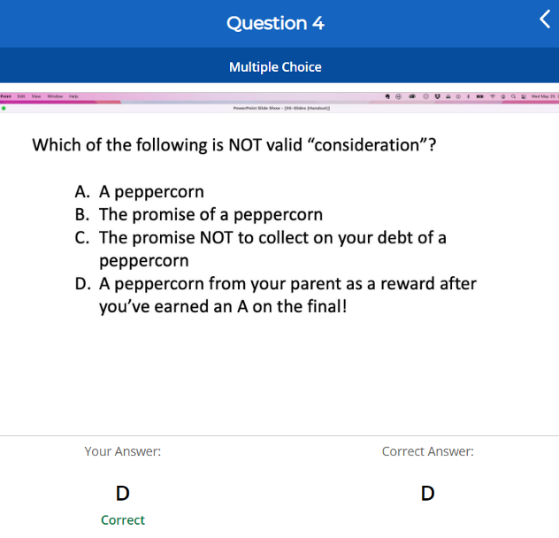
Clicker!

Slide 11
C counts as consideration in one of the cases
D does not count because it is merely a promise. Consideration must be at least something of value

Slide 12
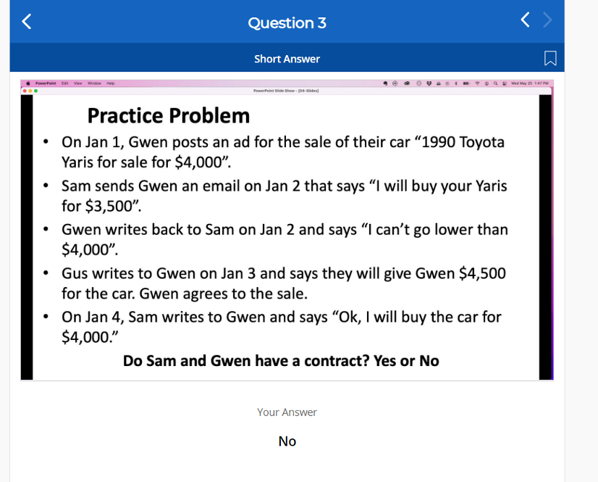

Slide 13
THE ANSWER IS YES
The reason is because there's two contracts here and Sam would be in breach of the original contract between her and Gwen
Sam can only revoke the contract BEFORE anyone has accepted

Slide 14
Question 2: Offer and Acceptance (5 minutes)
5neak8rokrs, a company owned and operated exclusively by Nalom, has recently run out of inventory and cannot supply its customers. Since the sneaker culture is on the rise, Nalom knows he has to provide sneakers to his most ardent sneaker-loving customers to be in their good graces. In search of supply, Nalom went onto the Facebook Marketplace, typed in “Jordan 4 Bred,” and began scrolling down the page. Hoping to find a steal on sneakers that he could sell to his customers for a profit, Nalom stumbled across an ad by Arbaj.
Arbaj is new to the sneaker game and has just won a raffle for a pair of Jordan 4s. He did not know the true value of the sneakers and decided to list his item on Facebook for a retail price of 200 dollars.
Assuming Arbaj did not know the actual value of the sneaker, Nalom tried to lowball and DM’d Arbaj on October 4th.

Slide 15
October 4th
Nalom: “Would you sell for 190?”
Arbaj: “200 dollars, no negotiations”
Although Nalom felt 200 dollars was a fair offer, his savvy and risk-averse mindset meant he wasn't going to invest 200 dollars in a sneaker before securing a customer. As a result, on October 5th, Nalom went to the SRC basketball court to meet up with Clint, one of Nalom's diehard customers, to inform him that he "had" a pair of Jordan 4 Bred on sale for 300 dollars. Clint was interested and the two started to negotiate.
Clint: “How about 250?”
Nalom: “Have you seen the prices on StockX? This shoe has nowhere else to go but up. 300 dollars is already a friends and family price!!!”
Clint: “Alright, you make a fair point, but I’ll only pay now if you ship it this week”
Nalom: “Anything for you my brother! DEAL!”
Clint: “Alright then, DEAL!”

Slide 16
After being bombarded with offers on the 4th, Arbaj decided to do some research and check out the true value of the sneaker. By the evenings on the 5th, he had updated his listing price to 350 dollars”.
Having just secured a deal with Clint. Nalom messaged Arbaj assuming the deal was still on the table.
October 5th
Nalom: “200 dollars, you got a deal, ship it to this address…”
Arbaj : “Missed your chance, tried to lowball when you had the chance. NO DEAL”
Feeling that he had been cheated out of a deal, Nalom was enraged and responded by saying:
“SEE YOU IN COURT! **** (FOLLOWED BY A SERIES OF PROFANITIES)”

Slide 17
Do Arbaj and Nalom have a contract? Explain the legal basis for your conclusions.
1. Do Clint and Nalom still have a contract if Arbaj fails to deliver the sneakers? Explain the legal basis for your conclusions.
2. Assume for c only, Nalom had already bought the Jordan 4’s from Arbaj and actually had a pair of Jordan 4’s to sell to Clint; however Clint had been visibly intoxicated when he made the deal to buy the sneakers from Nalom at the SRC basketball court. There were other players and security cameras at the basketball court at the time. If Clint were to wake up the next day and claim that he “had been too intoxicated to make sound judgements”, then would he be able to return the sneakers?

Slide 18
Contract-extra info
When does it lapse?
perishability
type of market, number of buyers
when the offeree fails to accept within a time specified in the offer
when the offeree fails to accept within a reasonable time, if the offer has not specified any time limit
when either of the parties dies or becomes insane prior to acceptance
Revocation?
if i promise to keep this contract open forever and i revoke this contract, does this contract still exist?
Counter Offer?
Any change in terms: including any alteration/modification of offer

Slide 19
Question 2 - Answer: Part 1
ISSUE: Do Arbaj and Nalom have a contract?
Related Cases:
R v. 279707 Alberta Ltd.
Hood v. Enwin Utilities Ltd.

Slide 20
LAW: Establishing a contract requires 5 elements
Intent: Presumed in business transactions between arm’s length parties (Doesn’t count if your mom tells you she will give you 5 dollars if you clean up your room).
Offer: An offer requires specific subject matter (what is it about), specific parties (who is involved in this contract) and a specific price/value [saying “significant reward” won’t suffice (recall the lost cat reward pamphlet); an advertisement alone is not an offer but merely an “invitation to treat” (recall pepsi harrier jet commercial example we talked about in class].
Acceptance: Effective when retrievable by the offeror unless the postal acceptance rule applies (once the buyer accepts, there is no room for recourse, regardless of whether or not the seller received the information that the buyer has accepted). If it is reasonable to accept by post (i.e. the contract specified so or the offer came by post), then acceptance is effective when sent (Hood). (also note: if we conversed through text/messenger, neither party should expect the acceptance of the contract to be via mail, court will only look at the most effective method of communication).
Consideration: Mutual exchange of promises (Caliguiri).
Capacity and Legality: Generally assumed unless otherwise stated (if the contract is some shady deal that violates public interest, then the contract would be considered invalid - capacity and legality are synonymous terms for this course).

Slide 21
Application and Conclusion
Intention: Was there clear intention between the parties, was Nalom looking to find a buyer? Did he approach Clint with the intention of selling him a pair of sneakers? Did Clint express his desire to own a pair of Jordan 4’s when they met up at the basketball court? Answers to all of the above is yes – intention established.
Offer:
Subject Matter: Jordan 4 sneakers.
Specific parties: Clint (prospective buyer) and Nalom (prospective seller).
Specific price/value: 300 dollars (beware: it is not 250 dollars because the offer lapses once a counter-offer is made, this question makes no mention to the counter-offer, but be mindful of this during the exam!)
Offer requirement fulfilled!
Consideration: Nalom is to deliver a pair of sneakers in exchange for 300 dollars from Clint. Consideration requirement is fulfilled.
Acceptance: Clint accepted when he (verbally) agreed on Nalom’s offer of 300 dollars for the Jordan 4 sneakers.
Capacity and Legality: Is there a violation of public interest? Does this deal jeopardize other people? Is it within the limits/scope/realms of the law? All of the above is yes, sneaker trade doesn’t negatively affect anyone, nor is this a black market deal etc… Capacity and Legality fulfilled.
Conclusion: the contract between Clint and Nalom is valid, present and in effect enforceable. If Nalom fails to deliver the sneakers on time, Clint will be eligible for damages and costs if the case is brought forth upon the court (civil court! Most likely small claims court) regardless of whether or not Arbaj delivers the good (two contracts, see next slide for more).

Slide 22
Extra Information for Pt 1
Explain that there are two contract formed in this case.
Arbaj and Nalom did not enter into a contract on the 4th but did so on the 5th because Arbaj never retracted the initial offer of 200 dollars.
Nalom agreed to 200 dollars before Arbaj informed him that the original offer has lapsed (Arbaj never retracted the contract), thus contract was still formed on the 5th regardless of whether Arbaj was willing or not.
The other contract is between Clint and Nalom and has no bearing on the contract between Nalom and Arbaj. These two contracts do not have any correlation with each another. The enforceability or unenforceability of one contract does not guarantee the enforceability or unenforceability of the other!

Slide 23
Question 2 - Answer: Part 3
ISSUE: Will the court order Nalom to give Clint a refund for the sneaker if the case was brought forth upon the court?
Relevant Cases: N/A

Slide 24
LAW: Contract unenforceable if buyer is inebriated under the following conditions
Contracts made with individuals who are lacking in capacity temporarily due to inebriation may be unenforceable against that individual. If it is a contract for a “necessity” (e.g. food, transport, shelter and basic clothing), then it would be enforceable against the individual regardless of the temporary incapacity and the inebriated party would have to pay a reasonable price. For non-necessities, the contract is not enforceable against the inebriated party, on the condition that such party is able to show:
They were incapable of rational decision making at the time the contract was made;
The other party (seller) was aware of this condition;
Buyer must act promptly on emerging from state of incapacity/inebriation (and cannot have accepted the benefits of the contract) to repudiate the contract.
Whether or not something is a necessity depends on the situation
In terms of clothing and sneakers, price and situation must be considered. (i.e if a drunk guy showed up without shoes to a store and purchases a reasonably priced item that will help keep his feet warm, then there is no claim which can be brought forth. If the clerk took advantage of somebody’s inebriated state and sold them a pair of Yeezys or Christian Louboutins, then it becomes something that is not a “necessity” and there will be a claim to be argued in court.)
There was external evidence such as witnesses and cameras that Nalom can point to.

Slide 25
Application and Conclusion
APPLICATION:
Jordan 4 are are expensive and can be considered as discretionary goods and thus cannot be considered as necessities.
Clint would be able to get refunds from Nalom - the offer made on the sneakers are priced at a premium!
To prove that Clint was incapable of acting rationally, cameras and video footage could be used. Testimonies could be made by Clint’s “binge drinking” mates and his basketball pals. Nalom was aware of Clint’s condition and blatantly took advantage of his vulnerability.
However, for Clint to be eligible for a refund, he must act promptly to repudiate the contract (call or meet up with Nalom the next morning).
CONCLUSION: Clint can get refunds from Nalom but only under the condition that he promptly repudiated against the contract to mitigate the risks that is involved (if he received the sneakers and tried them on and went out for a party before coming back to decide he can do without the sneakers and demand a refund from Nalom, then he (Clint) will not be eligible for a refund).

Slide 26
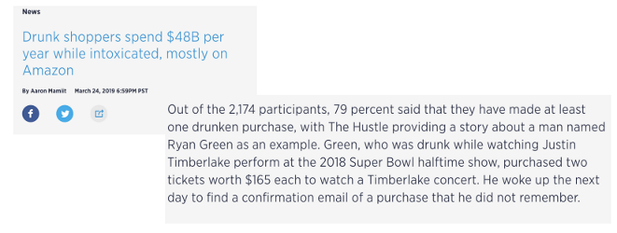
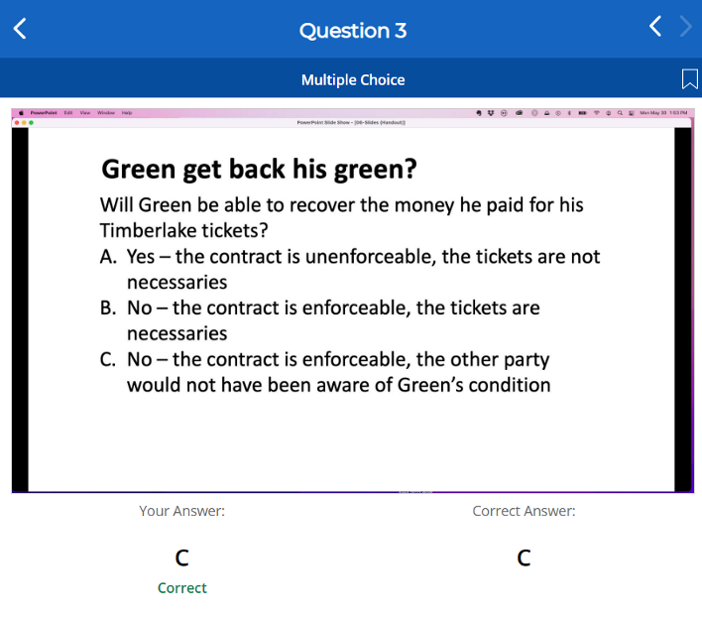
Capacity

Slide 28
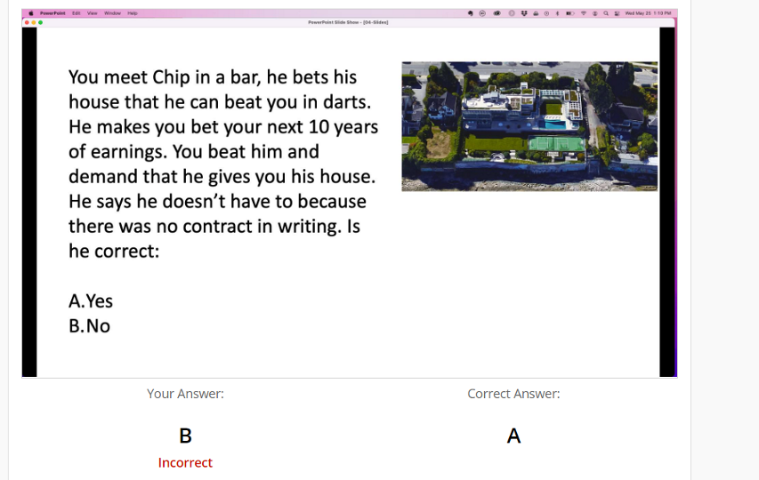
Contracts

Slide 29
Land is one of the only things that you need an actual written contract for to be valid

Slide 30
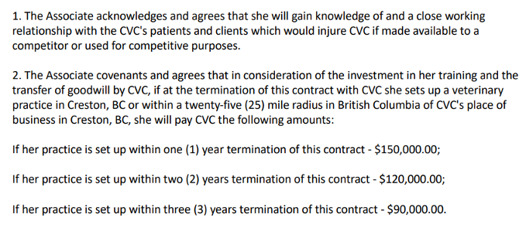
Restraint of Trade
Normally unenforceable, burden of proof on employer to show reasonable

Slide 31
Question 3 (6 minutes)
Spongebob works for Krusty Krabs Restaurants. Despite wanting to quit for a couple of months now, Spongebob would feel somewhat indignant if he wasn’t compensated fairly by his money driven boss, Mr Krabs. Having held the position as a chef for the last 3 years, Spongebob knows he will be eligible for 3+1 months of wages were he to be fired but will receive no compensation were he to voluntarily quit. In order to get himself fired, Spongebob purposely sabotages the restaurant operations and scatters food poisoning into the food that cooks. After receiving numerous complaints from loyal customers of the establishment, Spongebob is ultimately fired by his boss, Mr. Krabs. Ecstatic, Spongebob receives 4 months’ compensation and begins looking for other chef related jobs in town, only to find out that his contract has stipulated that he:
“The employee of Krusty Krabs for a period of four years following employment at Krusty Krabs:
“shall not, and shall not assist any third party to, conduct any business or be employed by any business in town of Bikini Bottom that competes directly with Krusty Krabs for a period of 4 years. A business that competes directly with Krusty Krabs shall include, but shall not be limited to, any restaurant or food related establishment, such as (but not restricted to): (i) another restaurant; (ii) offering gastronomy (food study) courses; (iii) catering services; or (iv) any entity employing the term “food based" in its name or description”; (v) talk to or engage in business with any existing Krusty Krab customers.
In the event that the employee has been fired, then the employee of Krusty Krabs will also agree that for a period of four years following employment at Krusty Krabs:
“shall not, and shall not assist any third party to, conduct any business or be (i) employed by any business underwater that competes directly and indirectly with Krusty Krabs, (ii) (this includes any hospitality related industry)”
*(Bikini Bottom has a population of 3,000,000)
Spongebob now holds jobs in both the hospitality and catering industry; some of Krusty Krabs former and existing customers are also customers at the entity Spongebob now works for, his former employer, Mr. Krabs is suing Spongebob for breaching the above clause in his employment contract.

Slide 32
Questions
Will Mr. Krabs be successful in his lawsuit against Spongebob?
Can Spongebob be employed at other hospitality related industry after the termination of his contract?

Slide 33
Question 3 - Answer: Part 1
Related Cases:
Maksymetz v. Kostyk
Phoenix Restorations Ltd. v. Brownlee
ISSUE: Can Krusty Krabs restaurant obtain an injunction and stop Spongebob from working at his current job? (i.e. Did Spongebob violate his employment contract?)

Slide 34
Law: Restraint of Trade
Law 1: this question involves a restraint of trade: all restraint of trade are “prima facie” unenforceable unless it can be proved reasonable by the claimant. Requires interpretations of the following two clauses/convenant:
Non Compete: It is clear and reasonably restricted as to time (not too long), geography (not too vast), nature of activities (not too broad).
Non Solicit: prohibits an employee from utilizing the company's clients, customers, and contact lists for personal gain upon leaving the company.
Phoenix v Brownlee test will be to determine whether the court will grant an interlocutory injunction in favour of Mr Krabs.
Phoenix v Brownlee is used to see if the non compete or non solicit is reasonable
(Reasonable with respect to the) Public Interest
A restraint on competition
(Depriving public of) special service
A legitimate proprietary interest entitled to be protected?
Is the restraint reasonable given:
Size of the restricted geographical area
Nature of activities prohibited
Length of restriction
Overall fairness
Are the terms certain? (i.e. clear and not vague).

Slide 35
Application
There is a restraint of trade, Mr. Krabs has many stipulations as to what Spongebob can and can’t do, thus the clause is prima facie unenforceable and Mr Krabs/Krusty Krabs will have to show that it is reasonable. The court will look at:
Legitimate Interest: Yes, there is a business interest that would be threatened if Krusty’s employees leaves to work for a direct/indirect employer of the restaurant.
Depriving Special Services/Public interest: Many restaurants in Bikini Bottoms, would not likely be depriving public of food that is cooked by one chef. Public’s interest unlikely to be jeopardized by this one action.
Restrain on competition/trade: Restricts competition; contract states Spongebob must not “be employed by any business in town of Bikini Bottom that competes directly with Krusty Krabs”.
Reasonable or too broad?
Geographic Area – the region of Bikini Bottoms is far too broad. The legitimate interests of the business would likely be restricted to a geographic area representative of such things such as client base. There are many people in Bikini Bottoms (3 million), it makes sense for the presence of more restaurants in the area to fulfil the demand.
Nature of Activities – too broad. Banning any type of service related to the food industry alone is too broad, not to mention the potential banning Spongebob from working in any hospitality industry as well.
Length of Restriction – 4 years is too long. A more reasonable length of restriction would be less than 2 years.
Overall Fairness – this is unfair. Assuming Spongebob has a limited skillset, the restrictive covenant essentially deprives Spongebob of all potential job prospects possible within Bikini Bottoms for a period of 4 years.

Slide 36
Conclusion
The terms are certain; however, given the information above, the court will likely decide that the contract is unenforceable. Courts will not “rewrite” a covenant to make the contract enforceable. Therefore, Mr. Krabs will not be successful in obtaining an injunction.

Slide 37
Question 3 - Answer: Part 2
Spongebob intentionally getting fired is express repudiation and Mr. Krabs will be eligible for damages but this has nothing to do with interlocutory injunction OR restraint of trade; as a result, Spongebob will be free to work where ever he likes.
Spongebob can be employed at other hospitality related industry upon the termination of his contract.

Slide 38
Question 4:
Manchester Red FC’s home stadium, "Old Trashford”, is a shell of its former self. Having not undergone any significant refurbishment over the last 70 years, its owners, the Glezer family, decided to hire Toober Construction Company Ltd to renovate the building. The contract has stipulated that Toober had to complete the stadium’s renovation by 1st January 2030. If the project cannot be completed within the agreed upon deadline, then the Glezer family is free to hire other construction companies while Toober constructions will be obligated to pay 50% of the project cost as damages to the Glezer family.
After 8 years of construction, Toober’s realized that magnitude of the task. They had significantly overestimated their ability to deliver the project on time. After consulting with the engineers, Toober’s came up with a new proposal that will see the stadium’s renovation being completed somewhere around September 2035. In 5th March 2028, Toober’s contacted the Glezer family and notified them of this new plan. The Glezer family responded by saying, “Take your time, there’s no rush, the fans aren’t going to leave anytime soon. You don’t need to pay us anything so long as the quality of the stadium is ensured”.
On May 23rd 2031, after a string of fan protests due to the decaying state of their home ground, supporters of the club started boycotting matches by not renewing their season tickets. In order to satisfy its fans, the Glezer family fired Toober Constructions and sued them for damages as stipulated in the contract. Upon receiving this news, Toober Constructions counter-sued the Glezer family for fraud and demanded compensation.

Slide 39
Will the Glezer family be successful in their lawsuit?
What about the counter action Toober Construction filed against the Glezer family?

Slide 40
Question 4 - Answer: Part 1
ISSUE: Can the Glezer family sue Toober Constructions Inc. for the late fees?
Related Cases:
Caliguiri v. Tumillo
Tulsa Heaters Inc. v. Syncrude Canada Ltd.
AMS Duke’s Cookies

Slide 41
Law: Promissory/Equitable Estoppel
LAW: Consideration is when there is a mutual exchange of promises between two parties. In the case where a promise is made without anything in exchange, it is called a gratuitous promise and will not be enforced by law (Caliguiri). However, promissory estoppel (or equitable estoppel) can be applied if the following elements are present (Tulsa Heaters):
There was a pre-existing contract between the parties;
One party made a gratuitous promise to relax strict legal obligations;
Other party relied on the promise, altered its conduct and now it would be a real hardship if the promise were not lived up to; and
Party who relied on the promise is using this as a shield, not as a sword, meaning they are using it to defend themselves in a cause of action.

Slide 42
Application and Conclusion
APPLICATION: When the Glezer's told Toobers Inc. they could complete the renovation sometime past the agreed-upon completion date, no consideration was received; therefore, this is a gratuitous promise, and hence it is unenforceable in the courts.However, by applying the principles and frameworks of promissory estoppel, the facts remain that it was the Glezer's who made a gratuitous promise to relax the delivery date of the renovation from 2030 to 2035. Toobers Inc relied on this new information, relaxed its present obligations and set its renovation completion date for Old Trashford to 2035. As per the terms in the contract, if the initial stipulations were not lived up to, the Glezer's would be free to fire Toober's without prior notice and demand damages. In this case, Toober's would inevitably suffer financial hardship as they would have to pay the Glezer's fees for late delivery through no fault of their own. To protect themselves against unjust lawsuits, Toober's could apply equitable estoppel to prevent incurring unnecessary legal bills.
CONCLUSION: Promissory estoppel would protect Toobers Inc. in this case and the Glezer’s would not be successful in bringing a legal action against Toobers Inc. in court. The Glezer’s would likely be liable for costs.

Slide 43
Question 4 - Answer: Part 2
Law: Party who relied on the promise cannot use promissory estoppel as a sword, that is, to bring a cause of action.
Apply: Toobers Inc counter suing the Glezer family would be considered as utilizing a sword against another party, given that it is not done in defence or protection of one's own interests.
Conclusion: Toober Inc’s counter action lawsuit against the Glezer’s would not be successful and Toobers Inc would not be able to obtain damages or costs.

Slide 44
Question 5:
Jonathan was 17 years old when he took out a 35 million dollar student loan so that he could afford to attend the UBC Sauder School of Business. Upon graduating at 21 years old with a BCom degree, Jonathon worked as a crypto trader that netted him $30 dollars per year (be careful with your money kids!). He had annual student debt obligations of 3 million dollars which he refused to pay, arguing that he had not yet saved enough money to become “financially independent”. He has recently received a letter from TD informing him that 5000000 dollars of his debt payments is overdue and if he did not pay, the bank will file a legal action against him that would force him to carry out the terms of the contract.

Slide 45
Is the contract enforceable? State relevant laws and cases if possible.
a) Assume that instead of a student loan, Jonathan signed a phone contract deal with Rogers for $30/month when he was 17. After turning 19 and experiencing multiple cell outages, Jonathan became angry with Rogers and stopped paying his phone bills for 6 months. Can the contract be cancelled?
b) What if he only paid for the 4th month after turning 19?

Slide 46
Is the contract enforceable? State relevant laws and cases if possible.
Issue:
Will Jonathan be liable for the $500,000 in loans?
Law:
The Age of Majority act sets 19 as the age of adulthood in BC.
Infants Act: Contracts entered into by minors with adults are enforceable against the adult, but not against the minor.
The exceptions are when:
Specified by statute (Canada Student Loans Act) or where capacity granted under the Infants Act
Affirmed upon becoming an adult
Performed or partially performed within one year of attaining majority
Example: paying a phone bill
Not repudiated within one year of majority
When a minor repudiates the contract, he must still pay the price for the portion that he has consumed
Section 21 infants act: infants can apply for contractual capacity with the court if determined to be in infant’s benefit and reviewed by infant’s guardians.
Canada Student Loans Act: student loans are still enforceable against infants.

Slide 47
Application: Because Jonathan was 17 when he took out the student loan, he was still considered a minor. Contracts are usually unenforceable against minors. Two exceptions: 1. minors can apply for contractual capacity but this would not apply in this situation as the loan is binding against Jonathan under the statute. 2. Canada Student Loans Act is still enforceable against minors.
Whether or not he is “financially independent” is irrelevant.
Conclusion: YES, he is liable for the loans. (pay for your loans guys)

Slide 48
2. a) Assume that instead of a student loan, Jonathan signed a phone contract deal with Rogers for $30/month when he was 17. After turning 19 and experiencing multiple cell outages, Jonathan became angry with Rogers and stops paying his phone bills for 6 months. Can the contract be cancelled?
Law: Infants Act states that minors must still pay a reasonable price for the benefit they obtained from the contract.
Application: he can cancel the contract because he did not perform the contract (did not pay) after turning 19 AND repudiated within a year. However, he must pay for the 6 months after he cancels because minors must pay for the portion they consumed. He would have been able to repudiate before turning 19, even if he performed the contract (paid for the bills). The cellular phone contract is a commercial contract, so this would not be enforceable against him.
2 b) What if he only paid for the 4th month after turning 19?
If he paid for the 4th month, then he would have partially performed the contract and would no longer be able to repudiate.

Slide 49
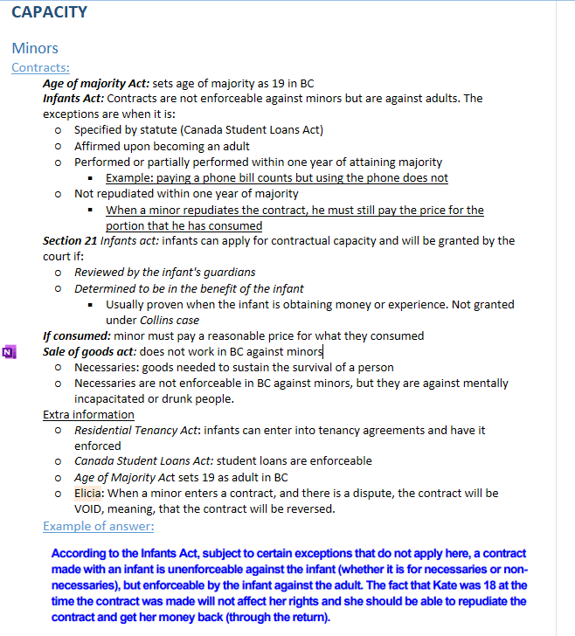
Example of notes from Tommy to show why important notes are important:
Because I made detailed notes and thought about the different situations that can occur, this question was much easier.

Slide 50
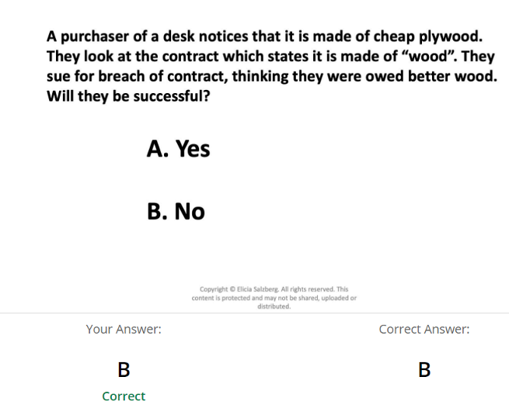
Interpretation Clicker

Slide 51
Purchaser of desk never said what type of wood is needed. In this case, plywood would work for a desk. Courts will look at the circumstance.

Slide 52
Question 6:
Mr. Porter, the principal of Etop School,wanted to overhaul the junk food centered lunch menu. Citing the recent article that “teenage obesity leads to higher blood cholesterol levels” as the reason for this policy, he implemented a meal plan where students receive vegetables and fruits as part of their daily meal. Given that the school’s kitchen has been out of order due to a recent ventilation system inspection by the city’s government, Mr. Porter had no choice but to outsource school meals to a company called “Healthy4U”. In the contract, the two parties agreed that:
“Healthy4U shall provide Etop with a comprehensive lunch menu that incorporates at least one vegetable dish and a piece of fruit everyday for the next 6 months”
After the contract had been signed, Healthy4U started providing packed lunches for the students at Etop. Packed lunches each day consisted of:
French Fries with limes or lemons of their choice
A protein
Milkshakes
Dessert of their choice (All desserts consisted of fruits)
Shocked and enraged by the food that was been served to the students of Etop, the school, after being pestered Mr. Porter, sued Healthy4U over its inability to carry out the terms of the contract. Healthy4U claimed that the company had not violated the terms and had indeed carried out what was expected of them since French Fries were made from “potatoes” (a vegetable by definition) and lemons/limes were considered as “fruits” by the Webster Dictionary.
What are Healthy4U’s chances of succeeding in court?

Slide 53
What are Healthy4U’s chances of succeeding in court?
LAW: Courts apply the 5-part interpretation test, going through each step until there is a clear answer.
Apply literal or strict meaning- the dictionary meaning or approach
Exam question will likely give this to you
Liberal or purposive approach, including circumstances surrounding negotiations, knowledge of parties and other relevant facts, including trade usage.
eg. What was the hardwood bought for? What did the other party sell it for?
3.Contra Proferentem. If a court is unable to resolve a contradiction or ambiguity, contra proferentum will apply: the contract will be construed against its author.
4.And in the cases of insurance:
Follow the rule
Construe the coverage broadly
Interpret the exclusion narrowly
5.All while avoiding an absurd result and deferring to sound and reasonable commercial practice
examine the market value of the items
Special usage of words: some words have a special industry meaning (baker's dozen)
Conflicting testimony:
Look to external objective evidence (bring in expert)
Consider credibility of witness: how consistent are they

Slide 54
Application
The strict and literal meaning of vegetable and fruit would prevail here and Healthy4u can win
Tommy: If the question seemed too easy and you wanted to apply the rest of the steps, what you can do is write “however, if the literal meaning didn’t work here, we can continue with the rest of the steps”. This allows you to get partial marks in case you made a mistake early on.
ELICIA: if there is a dictionary definition on an exam, DEAD GIVEAWAY that it's an interpretation question
liberal approach: if negotiations demonstrated that the school indeed wanted a healthy lunch for their students, then we can argue that French fries and limes are not sufficient for vegetables and fruits in this context.
Special usage of words: you might also argue that there is a special meaning of “vegetables and fruits” in the context of school lunches in the industry, but would be difficult. Still worth a try if you have time.
Example: Sawdust in the wood industry
If this part still fails in your eyes, you can move onto the next one.
Contra proferentum: because the contract was drafted by Healthy4u, the court will interpret the clause against them.

Slide 55
Question 7
Tonald Drump, a property developer based out of New York, has purchased an empty lot at UBC to build a statue of himself. Tonald’s development company contracted Graham Constructions, a local construction firm based out of Vancouver for $100,000 and specified the dimensions of the statue as “tremendous, very tremendous”. After construction was completed, Tonald immediately filed 7 lawsuits against Graham construction claiming that the statue was “not tremendous, but very pathetic at only 10 meters”.

Slide 56
If these lawsuits were filed in BC, which court will they be filed in?
If these lawsuits were filed in New York, what can Graham Construction do?
What are some alternative ways they could approach this dispute? List pros and cons

Slide 57
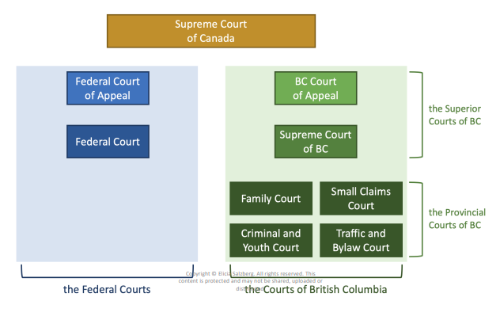
Answers
1. This would be filed in the BC Supreme court because Small claims can only file up to $35,000. If Tonald wanted to sever $65,000 and only file for $35000, then he can file in the Small Claims court.

Slide 58
2. If these lawsuits were filed in New York, what can Graham Construction do?
Graham Construction can argue for Forum Selection.
Law: Presumption of the jurisdiction is the location of the forum specified in the contract OR where the contract was accepted.
To rebut the presumption, it must pass in a majority (⅗) of the following factors. Microsoft v Rudder Test:
Where is the evidence? Is it convenient or expensive for a party to get to the jurisdiction?
Does the law of the foreign country apply?
When I took the course, only special law is privacy law in Douez
Strength of jurisdictional connection to parties
Where do the parties work and live?
Is enforcement genuine or is it just for procedural advantage?
Is a court being selected for a procedural advantage like time?
The other party cannot bring the claim in fast enough
Will plaintiff suffer prejudice by bringing claim in foreign court?
Does the court always rule in favor of the home party?
*Note: Applying Douez also works, but Microsoft V Rudder is the one we used.*

Slide 59
2. If these lawsuits were filed in New York, what can Graham Construction do?
Application:
The presumption for forum selection is the jurisdiction that the contract was accepted in, meaning it would normally take place in BC if they signed the contract in BC. However, because there was a clause specifying New York, Graham would need to run the Microsoft v Rudder test. They would need to prove that at least 3 out of 5 of the factors favor them. Postal acceptance might be relevant too.
Evidence is located in Vancouver at UBC as that is where the statue is located. It would cost Graham valuable time and money to continuously fly to New York for every court appearance. This favors Graham.
Law of foreign jurisdiction: There is no special law in BC that should govern this contract, such as the privacy law in Douez. This favors Tonald
Jurisdictional connection: Tonald Drump has a connection with New York because that’s where his head office is located. Graham has a connection to BC because that’s where his main work is located. However, it can be argued that because Tonald’s development company is also expanding with development work located in BC, they would also have a jurisdictional connection to BC. This would likely favour Graham.
American courts are proven to be quite fair in deciding commercial cases, so there is no prejudice suffered by Graham Construction. This favors Tonald
Graham would definitely suffer prejudice be traveling to New York while Tonald could appear in New York court easily. This favors Graham.
Conclusion:
This would narrowly favor Graham and the forum would be moved back to BC’s supreme court.

Slide 60
Forum Selection
When no forum selection clause:
forum selection is based on where the offer had been accepted
(letter of acceptance)

Slide 61
Question 8
Vancouver is undergoing a marijuana problem. Ever since its legalization in 2015, it has been a major issue for colleges across Vancouver, with many students at UBC coming to class high. As a result, the BC government passed a law stating that any student who is inebriated with marijuana in his or her system can be charged with a criminal offence, jailable with a prison time up to 2 months, provided they were on university or college property at the time of inebriation.
If you were a student charged with this offence, could you challenge this newly enacted legislation, if so, how?

Slide 62
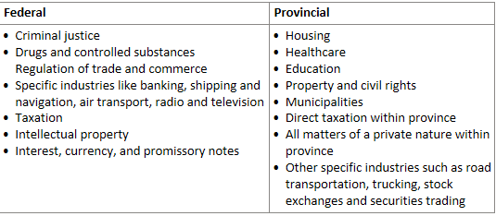
If you were a student charged with this offence, could you challenge this newly enacted legislation, if so, how?
Law: Section 91 and 92 of the Canadian Constitution Act lays out federal and provincial powers.
Ultra Vires 2-part test: establishes if a law passed by a government is outside of their jurisdiction under sections 91 and 92
Pith and substance: what's the purpose of the law and primary topic of the law?
What jurisdiction does this fall under?
Double aspect: when an area of law can be regulated by both the federal and provincial government harmoniously
Federal paramountcy: when there is a conflict over jurisdiction, the federal government prevails. This usually happens when a law by prov or federal gov are both valid under Section 91 and 92.
NFTS, for example
Out of scope (does not apply to subject matter)

Slide 63
If you were a student charged with this offence, could you challenge this newly enacted legislation, if so, how?
Application
The powers that are in question here are the provincial power over education and the federal power over criminal justice. As a student, you would challenge the BC government claiming that they lack the power to pass any laws that can be considered a criminal offence.
The courts would run the Ultra Vires 2 part test.
Pith and substance: although this law does concern education the main effect of the law is that it is a criminal offence related to students, which is a power exclusively reserved for the courts
Jurisdiction: criminal justice is under federal jurisdiction.
Double aspect would not apply in this situation
Conclusion:
Although this law attempts to regulate provincial education, the BC Government is not allowed to regulate criminal activity. Running the ultra vires test would mean the court would strike down the law.

